Slide 1
Amazon Redshift and Amazon QuickSight
Data Warehouse and Business Intelligence Modernization
Wendy Wong

Slide 2
Table of contents
Quick Intro
Synopsis
High Level Architecture
Amazon Redshift Cluster
Demo

Slide 3
Quick Intro
Notes:
I am an AWS Community Builder in data, data scientist and also a Business Performance Analyst at Service NSW. I have consulted and instructed in data analytics and data science for government, financial services and startups for 6 years. It was at an AI startup and at Service NSW that I used Amazon services including Amazon S3, Amazon Sagemaker, Amazon Redshift and Amazon QuickSight.

Slide 4
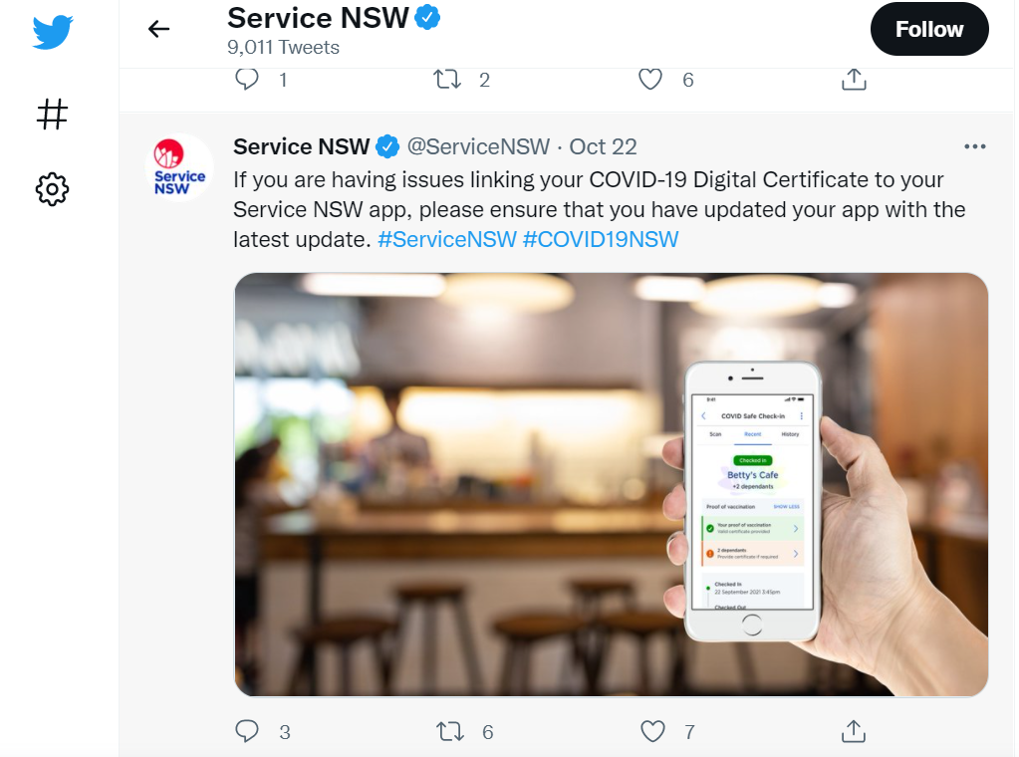
Quick Intro
Service NSW is part of Department of Customer Service
One stop shop NSW government agency
Our vision to become the world’s most customer-centric government agency
Notes:
We serve 4.8 million NSW citizens across contact centres, mobile apps and service centres. Service NSW is the startup of the Department of Customer Service and we support agencies and customers on a wide range of topics including Dine & Discover, covid vaccinations, licensing renewal, Trainlink and Creative Kids.

Slide 5




Synopsis
We built a well-architected modern data analytics pipeline with a fully-managed, petabyte-scale cloud data warehouse using Amazon Redshift under the Department of Customer Service using AWS Organization.
With lake house architecture we integrated a data lake, data warehouse and business intelligence with security, performance, elasticity, data velocity, cost effectiveness and governance to design a unified analytics platform for our organization-wide data architecture roadmap.
Amazon Redshift has massively parallel processing (MPP) for fast and complex queries and can analyze all our data
AWS services used:
Amazon Simple Storage Service (Amazon S3)
AWS Glue
Amazon Redshift
Amazon QuickSight

Slide 6
High Level Architecture

Slide 7













Challenge: Variety of data sources and data types
Data lake
1 Operations data
2. Department data
3. Extract, transform & load data
4. Business Intelligence and reporting
Notes:
We have the task to improve customer experience to understand NSW citizens

Slide 8

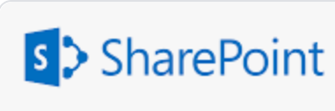

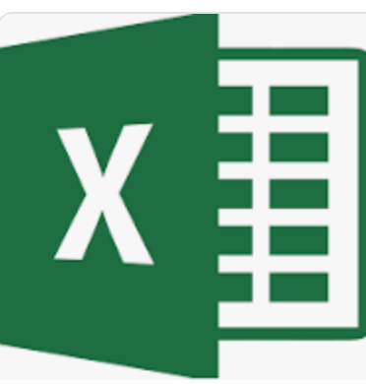



High-level architecture
AWS Cloud
Data Sources
Business intelligence and reports
Scalable data lake
Data Processing
Query data from
data warehouse
Mobile client
Ingest data
Load data
ETL
Amazon Simple Storage Service
AWS Glue
Amazon Redshift
Amazon QuickSight
Mobile client
Amazon Simple Storage Service
Data ingestion layer
Ingest raw datasets into the data storage layer
Data processing layer
Transform and load data
Data consumption layer
Data is loaded into the Amazon Redshift cluster
Multimedia
Notes:
We created an Amazon Redshift cluster with one leader node and 3 compute nodes. This was a greenfield government project. The challenges include creating an Active Directory, IAM User Role to create Redshift cluster and permission access to connect to Serverless BI (Amazon QuickSight) and Serverless ETL (Amazon Glue).

Slide 9





Solution: Lake house approach
Analyze all our data, unified data access
Cost-effective
Scalable workloads
Run fast and complex queries
Access to analytical services for ETL
Lake house architecture
Our Requirements:
Tableau Server and Amazon Redshift
Fast SQL query performance
Unstructured data can be stored in Amazon S3 data lake
Fully managed enterprise data warehouse on AWS
Based on PostgreSQL
CRM data connector
Public Cloud 2
Data connector
Relational Database
Data lake
Public Cloud 1 Data Connector
Data Warehousing
Machine Learning
Notes:
We have the task to improve customer experience to understand NSW citizens by building a data architecture roadmap to include business intelligence, reporting with structured, semi-structured and unstructured data and building machine learning capability for sentiment analysis and topic modelling

Slide 10
Amazon Redshift Architecture
Client Applications
Leader Node
Client
Compute
Compute
Compute
Client
Client
Client applications: Amazon Redshift integrates with ETL and BI
Connections: Amazon Redshift communicates with client applications using JDBC and ODBC drivers for PostgreSQL e.g. Tableau and Pentaho
Leader Node: Communicates with compute nodes to perform database operations
Compute Nodes: Leader node compiles code the execution plan and assigns the code to individual compute nodes
Node Slices: A compute node is partitioned into slices. Each node processes a
portion of the workload assigned to the node
Columnar data storage
Columnar storage for tables optimizes analytic query performance to drastically reduces the overall disk I/O requirements and the amount of data you need to load from disk.
Massively parallel processing (MPP)
Amazon Redshift distributes the rows of a table to the compute nodes so data can be processed in parallel
Notes:
Amazon Redshift is an enterprise data warehouse fully managed on AWS. Customer thinks about servers. How much RAM? How much CPU is needed?
Deployment Considerations: Good data model, Optimize Amazon Redshift Cluster. Columnar storage
Fewer joins, denormalizing table schemas and keeping columns sizes in tables as narrow as possible. All of these will improve query performance

Slide 11
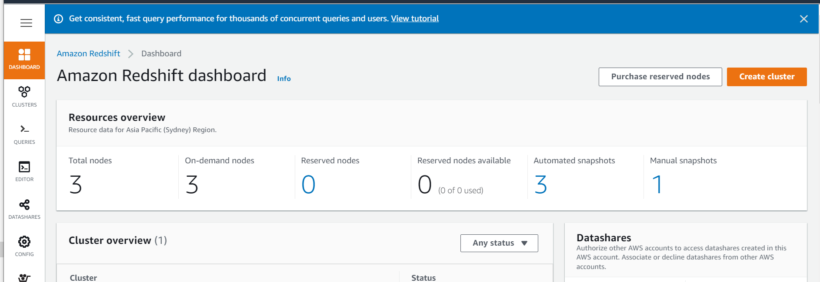
Amazon Redshift Cluster
The Amazon Redshift cluster was launched and configured using Cloud Formation
1 cluster, 1 leader node and 3 compute nodes
Node type: dc2.large with storage 160 GB/node. $0.25/node/hour. DC2 high performance
Cluster permissions: IAM role created for the Amazon Redshift role for our IAM User Group
Cluster Details: Database details created with database port number 5439
Network and security: Two subnets created in two different AZ to improve fault tolerance

Slide 12
Demo Create an Amazon Redshift Cluster

Slide 13
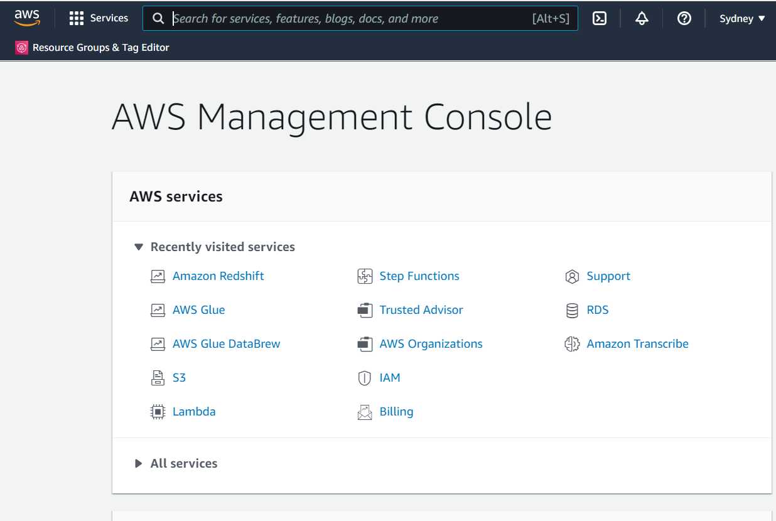
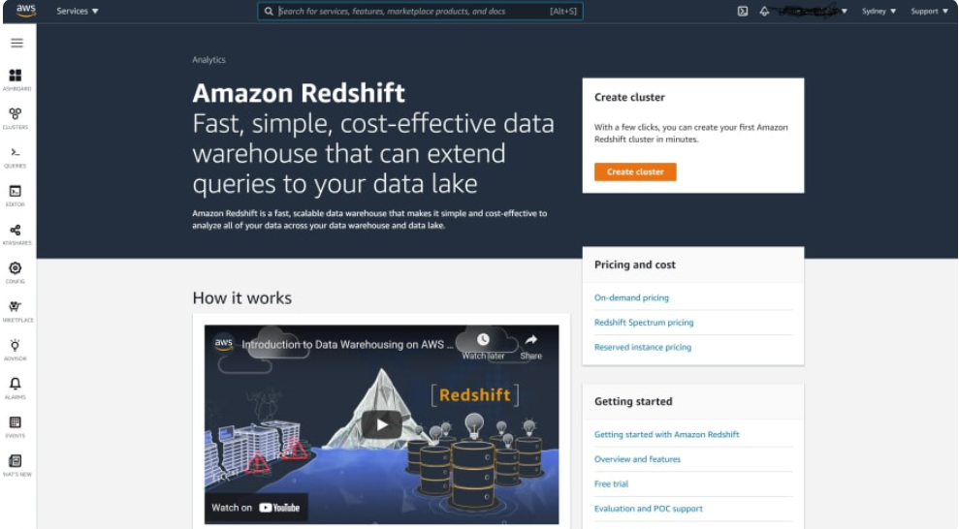
Demo: Create an Amazon Redshift Cluster
Step 1: Login in to AWS Management Console
In the Amazon Management Console you may type Amazon Redshift in the search bar
Step 2: Navigate to Amazon Redshift home page
Click on Create cluster

Slide 14
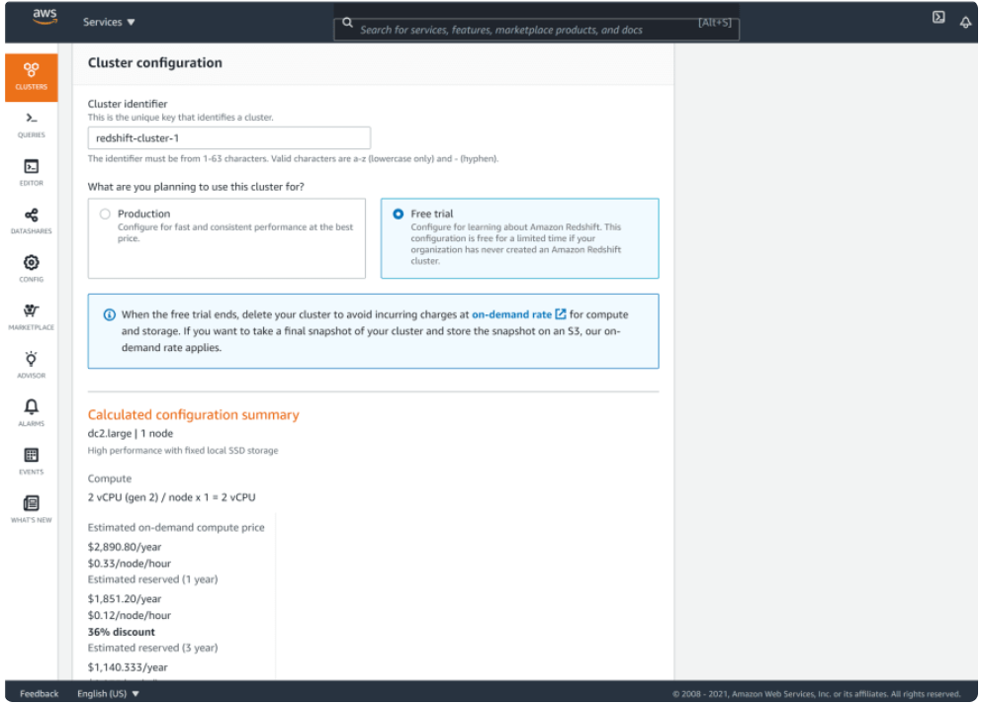
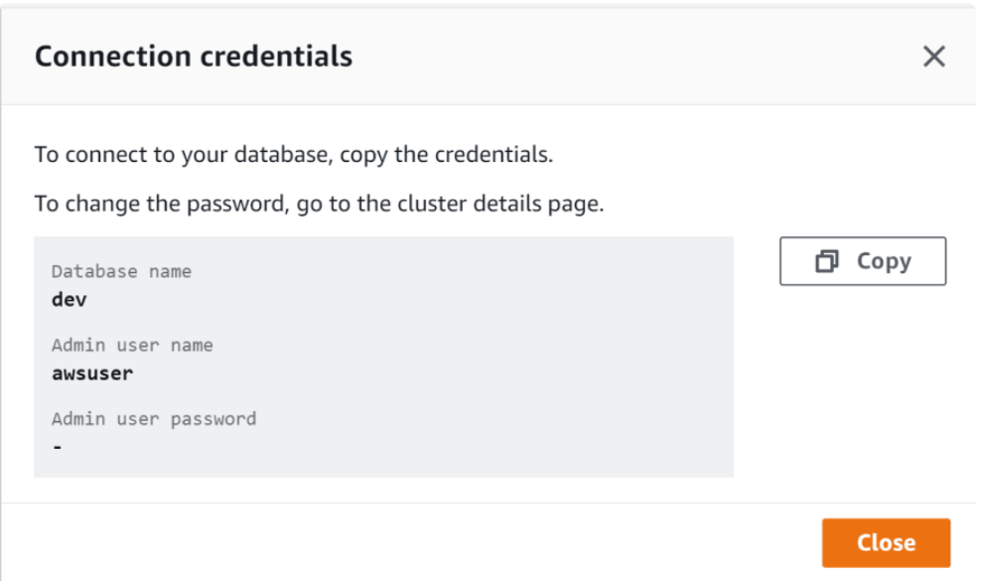
Demo: Create an Amazon Redshift Cluster
Step 3: In Cluster configuration provide a name for your cluster
If your organization has never created an Amazon Redshift cluster you may access the Free Tier, otherwise click Production
Step 4: Configure cluster:
Cluster identifier
Node type: dc2.large
Nodes: 3
Step 5: Database configuration:
Master username:
Master password:

Slide 15
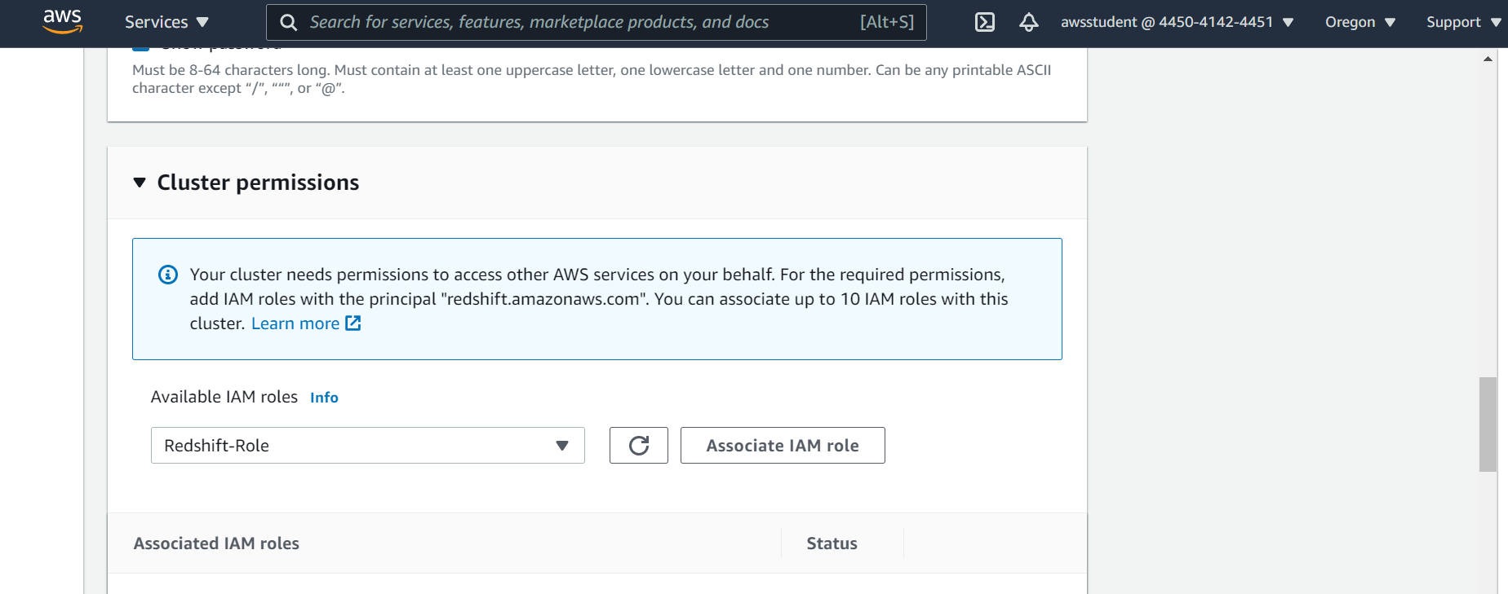
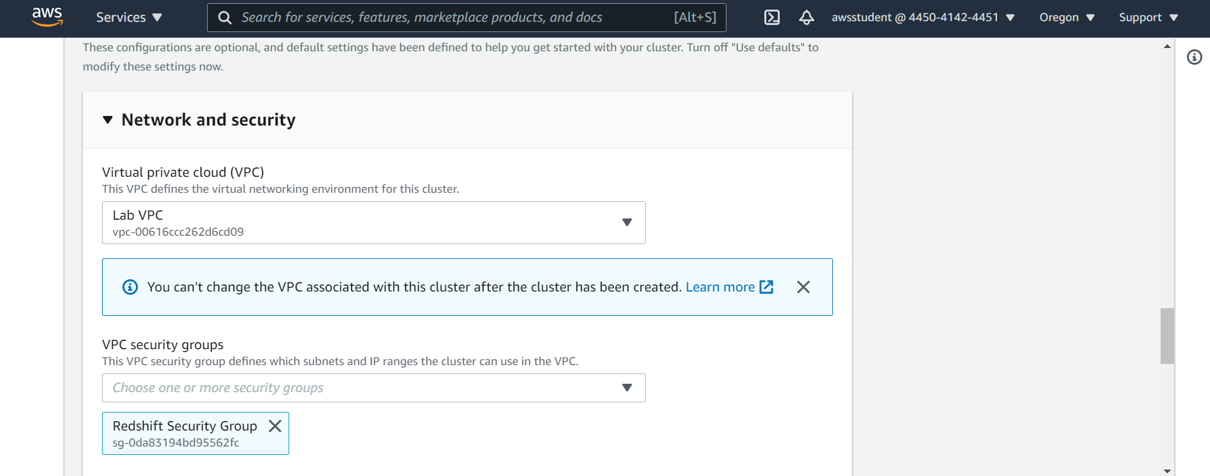
Demo: Create an Amazon Redshift Cluster
Step 6: Configure Cluster Permissions
In order for Amazon Redshift to have access to Amazon S3 to load data an IAM role is created to access to cluster via a Redshift role
Step 7: Security Group
VPC and security group attached to the VPC will be created by your administrator
Subnet Group is also created by your administrator

Slide 16
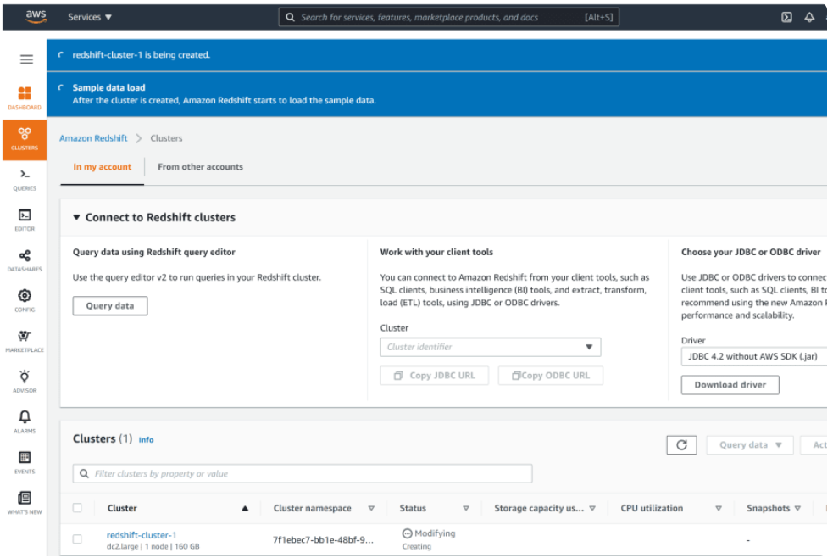
Demo: Create an Amazon Redshift Cluster
Step 8: Click close to create cluster
It will take a few minutes for the cluster to be provisioned and you can check the status of the blue banner

Slide 17
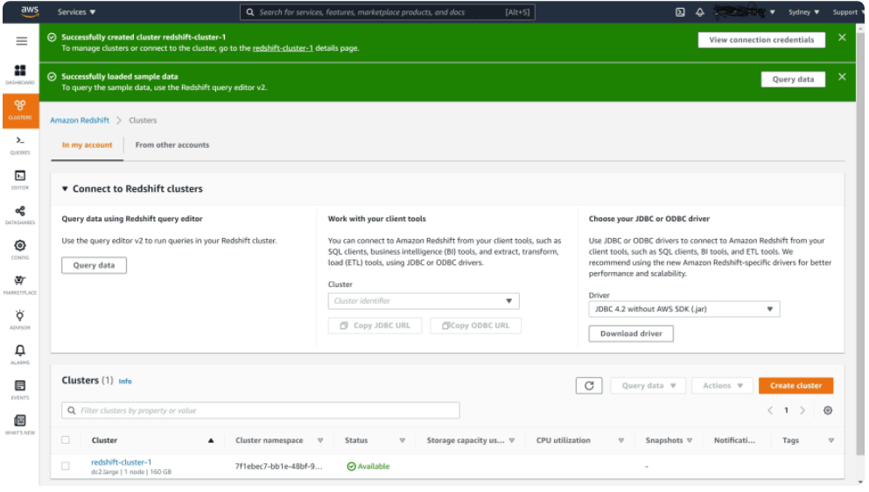
Demo: Create an Amazon Redshift Cluster
Step 9: Cluster created
After your cluster has successfully been created, the banner message will turn green and the created cluster will have a green tick with the wording 'available'

Slide 18
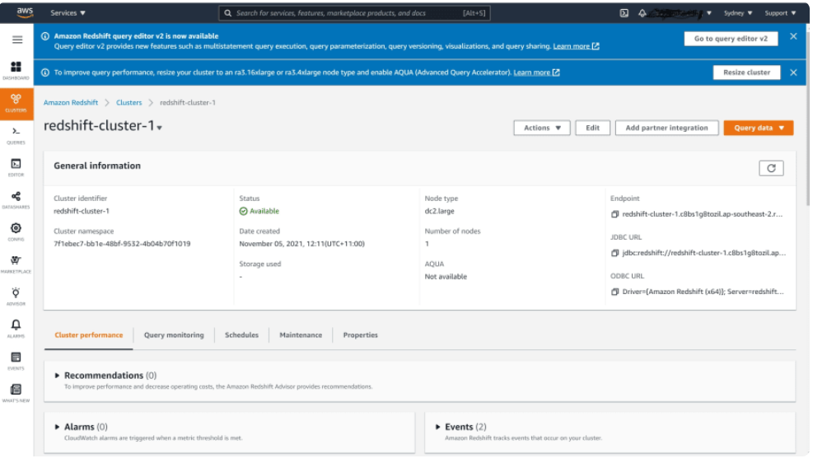
Demo: Create an Amazon Redshift Cluster
Step 10: Inspect the properties of your Redshift cluster
You may even download any JDBC and ODBC drivers
You may resize the cluster if required

Slide 19
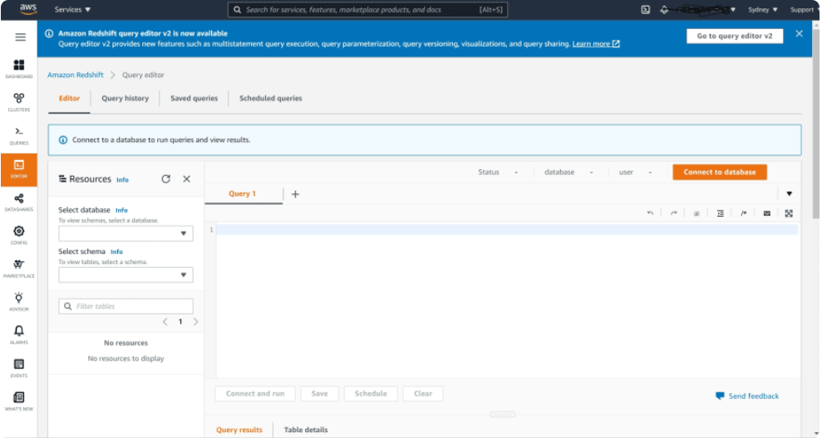
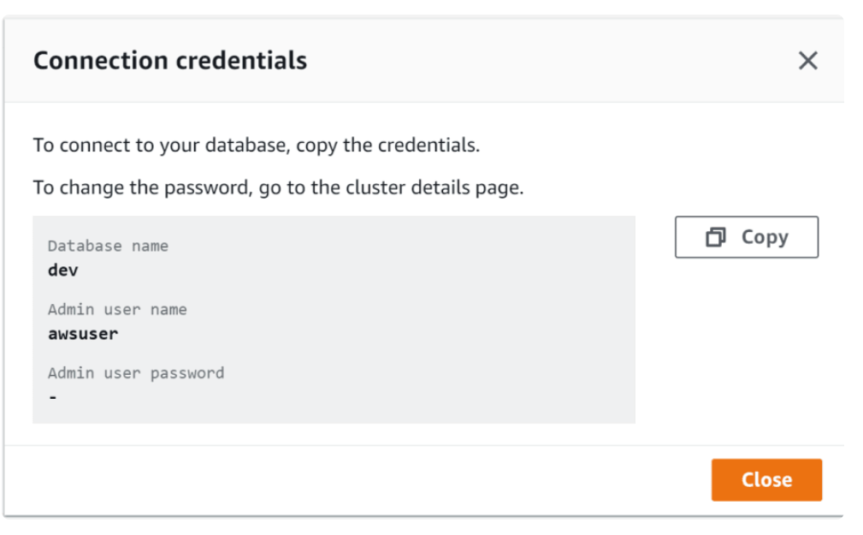
Demo: Query Editor
Step 11: Click Query Editor
Connect to the database
Enter the database credentials that were used to create the Amazon Redshift cluster

Slide 20
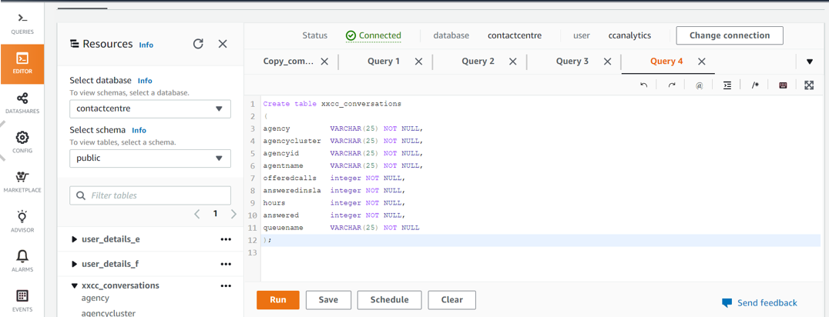
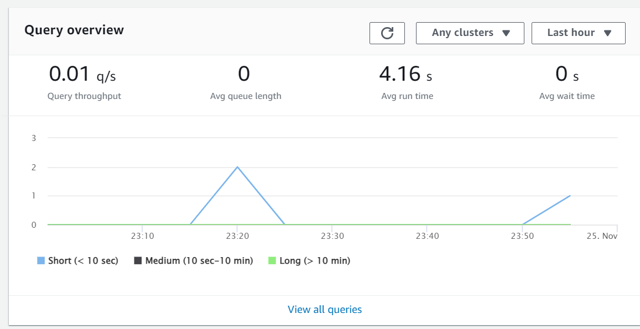
Demo – Query Editor – Create a Table
Step 12: Create a Table
Query Editor uses standard SQL commands to create a table

Slide 21
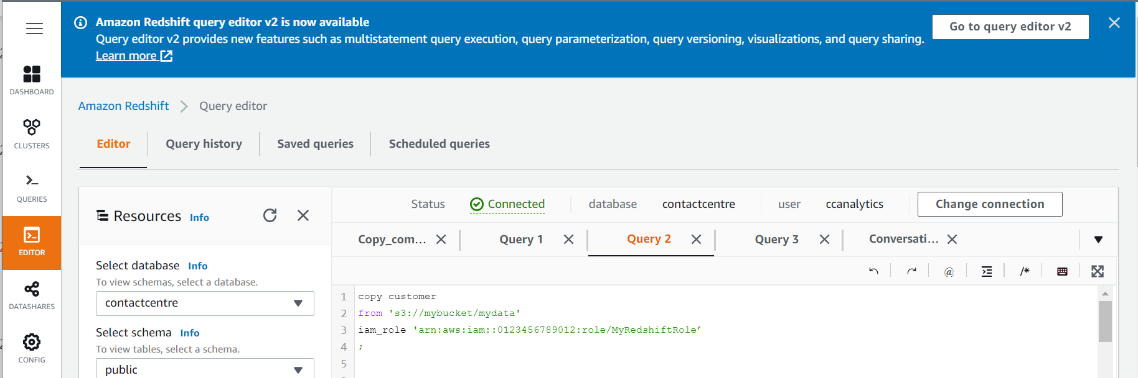
Demo – Load data from Amazon S3 using COPY command
Step 12: Load data from Amazon S3 into Amazon Redshift
The copy command

Slide 22
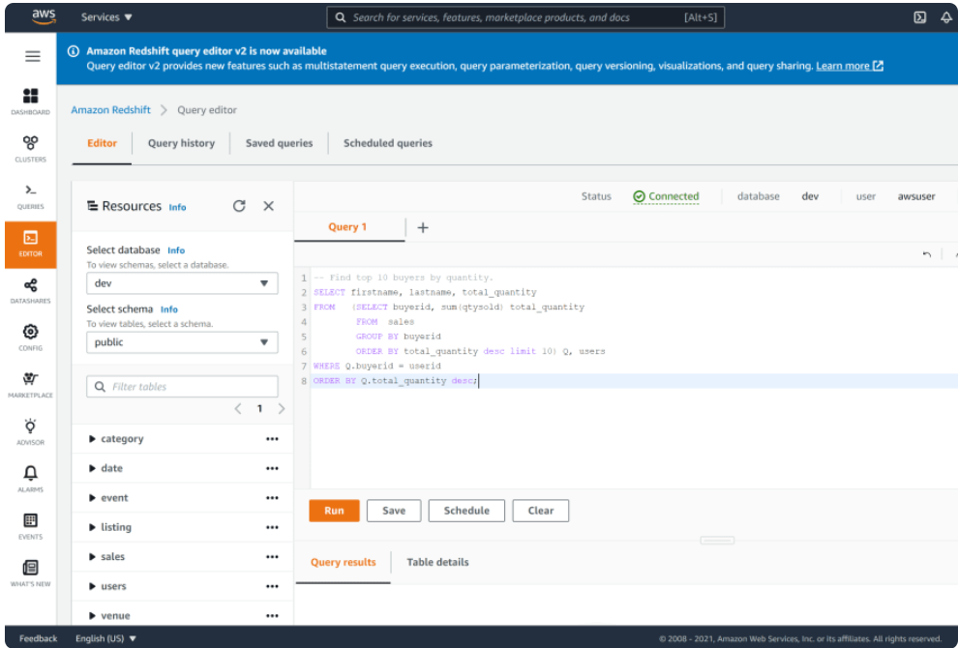
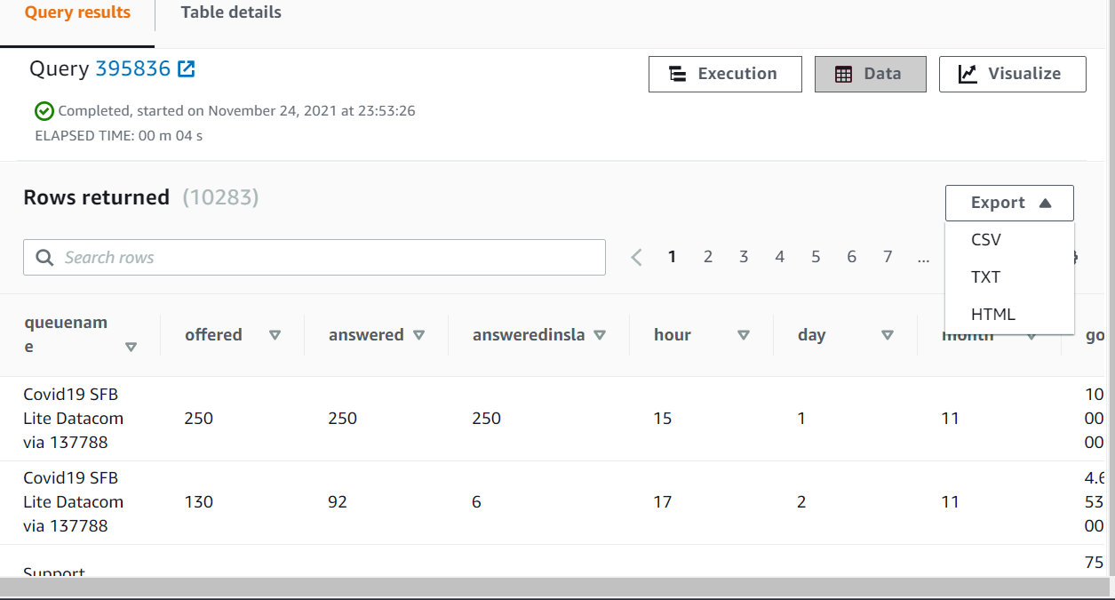
Demo – Query data from Amazon Redshift
Step 14: Fast Querying
SQL queries may be saved and scheduled
SQL queries can return results in milliseconds
Export results

Slide 23
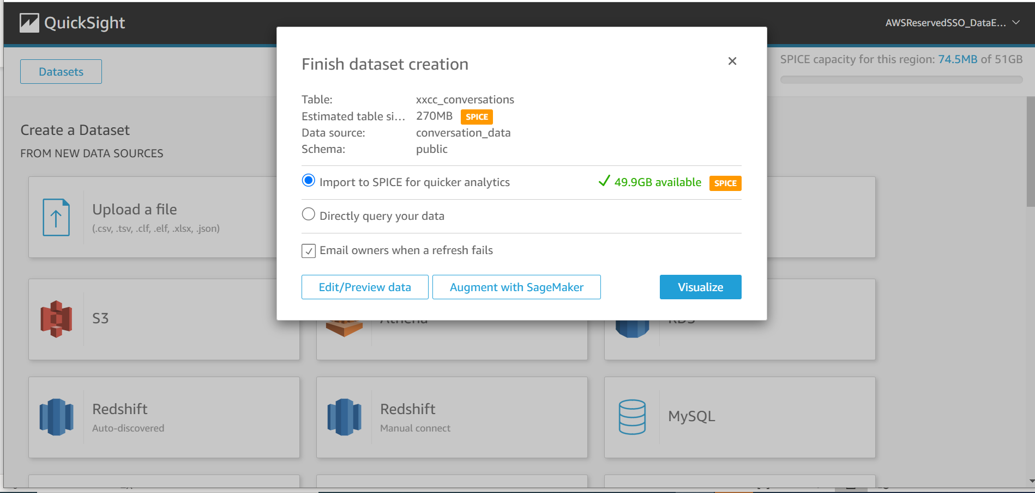
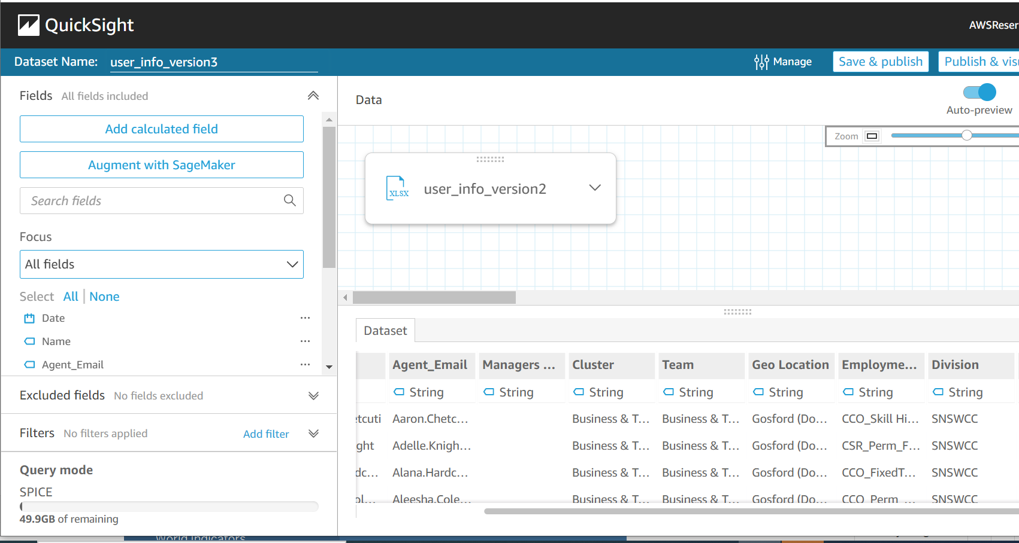
Demo – Connect Amazon Redshift Data to Amazon QuickSight
Step 15: Connect to Amazon Redshift database
Upload data by connecting to the Amazon Redshift cluster
Step 16: Review the data
Preview and format data in Amazon QuickSight before it is loaded into SPICE
Notes:
You may preview the data type before data is loaded into SPICE

Slide 24
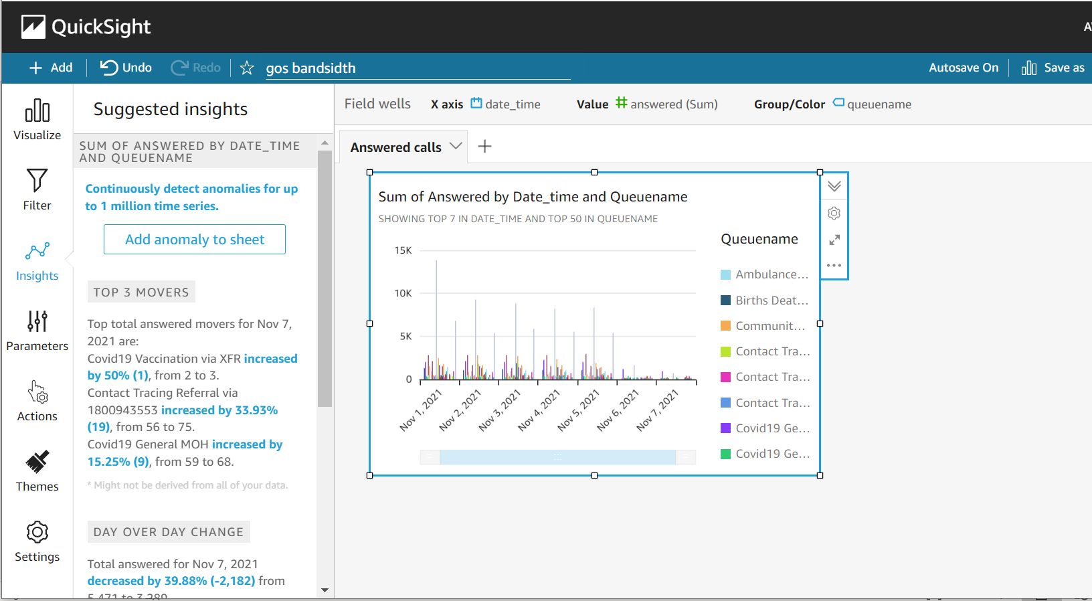
Demo – SPICE and Amazon QuickSight

Slide 25
Resources
https://docs.aws.amazon.com/redshift/latest/mgmt/query-databases.html
https://docs.aws.amazon.com/redshift/latest/dg/redshift-dg.pdf
https://docs.aws.amazon.com/redshift/latest/dg/c_loading-data-best-practices.html
Data warehouse system architecture - Amazon Redshift

Slide 26
Q&A
Wendy Wong

